Slide 1


Introduction to Cybersecurity
Topic 2: Linux and Networking
CITS1003
Jichunyang Li
Computer Science and Software Engineering
School of Physics, Mathematics and Computing
Acknowledgement: The lecture slides are prepared based on online resources.

Slide 2
About me
Unit Coordinator
CITS3401/5504 – Data Warehousing
Associate Lecturer
CITS1402 – RDBMS
Research Areas
Data Warehouse/Database/Graph Databases
Prompting Engineering

Slide 3
Learning Objectives
By the end of this session, you will be able to:
Discover: Scan remote servers for open ports using nmap
Communicate: Send and receive raw TCP messages with netcat (nc)
Version Control: Clone Git repositories via HTTP
Access & Transfer: Connect via ssh and move files securely with scp

Slide 4
How Computers Communicate
Every device on a network is identified by an IP address (e.g. 192.168.1.10)
Data doesn't travel as one big chunk. It's broken into packets, each routed independently and reassembled at the destination.

Slide 5
TCP/IP Network Model
The TCP/IP model describes how data travels across a network, organised into 5 layers:
Layer | What it does | Examples
Application | Defines how apps communicate with each other | HTTP, HTTPS, SSH
Transport | Manages end-to-end delivery between processes | TCP
Network | Routes packets across networks via IP addresses | IP, ICMP
Data Link | Transfers data between directly connected devices | Ethernet, Wi-Fi
Physical | Transmits raw bits over a physical medium | Cables, fibre, radio

Slide 6
Where Do Our Tools Fit?
Using the TCP/IP model, we can place the protocols covered in this topic:
Layer | Protocol / Tool | Notes
Application | SSH | Encrypted remote shell — runs over TCP port 22
 | HTTP | Web traffic — runs over TCP port 80
 | HTTPS | Encrypted web traffic — runs over TCP port 443
 | Git (HTTP/HTTPS) | Version control transfers use HTTP/HTTPS
Transport | TCP | The underlying transport for all of the above
Internet | IP | Routes packets between machines using IP addresses
Key takeaway: TCP lives at the Transport layer — it provides the reliable connection that SSH, HTTP, and HTTPS all depend on at the Application layer above it.

Slide 7
Ports: The Doors to a Server
Every networked machine has 65,535 TCP.
Port ranges:
0–1023 — Well-known ports. Reserved for standard services (SSH=22, HTTP=80, HTTPS=443)
1024–49151 — Registered ports. Used by applications and databases
49152–65535 — Dynamic/ephemeral ports. Assigned temporarily to clients

Slide 8
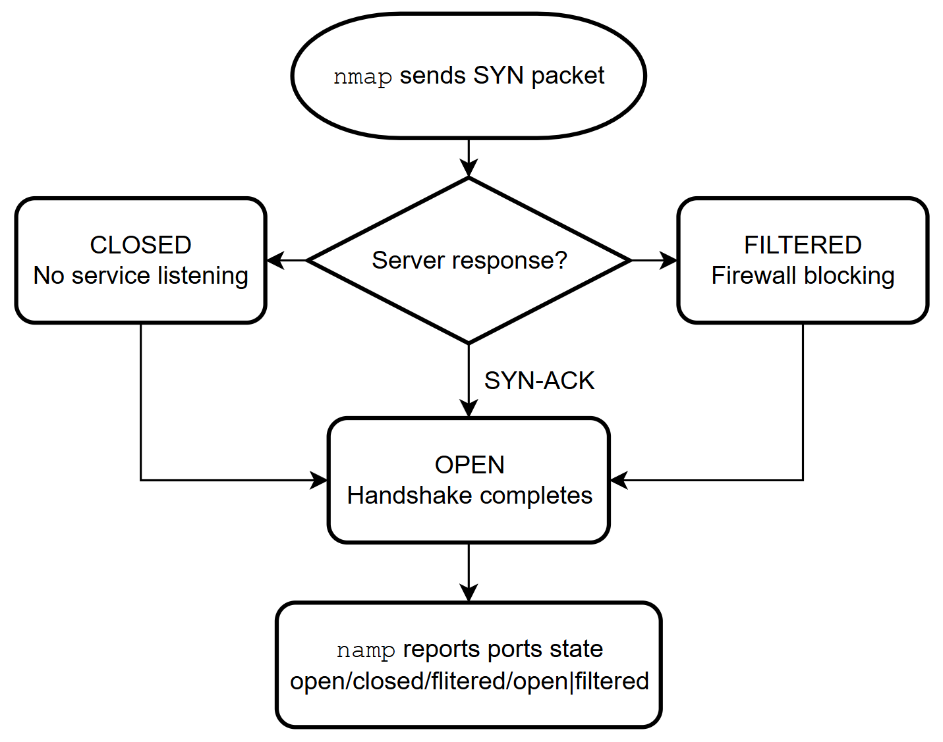
TCP 3-Way Handshake
Before any data is exchanged, TCP establishes a connection in three steps:
SYN
SYN-ACK
ACK

Slide 9
nmap
Tool 1 — Port Scanning Discover which ports are open on a remote server.

Slide 10
What is Port Scanning?
Port scanning is the process of systematically probing a machine to find which ports are open and what services are running.
⚠️ Ethics & Legality: Always scan systems you own or have explicit written permission to test.

Slide 11
nmap: How It Works
nmap probes ports and interprets responses to determine their state.
Main scan strategies:
TCP Connect Scan

Slide 12
nmap: Reading the Results
Port states you'll see in scan output:
State | Meaning
open | A service is actively listening. You can connect to it.
closed | Port reachable, but no service is listening.
filtered | Firewall likely dropping packets. State unknown.

Slide 13
Demo 1
nmap
Scan ports on a remote host
Identify port states: open, closed, filtered

Slide 14
netcat
Tool 2 — Raw TCP Communication Send and receive data directly over TCP.

Slide 15
What is netcat (nc)?
netcat reads and writes data across network connections using TCP.
Unlike a browser, it sends exactly the bytes you type and shows exactly what the server sends back.
Capabilities:
Simple file transfer
Port testing

Slide 16
netcat: Client–Server Model
Server
Waits, always ready
Client A
Client B
Client C
Clear role – One waits, one connects
One-to-many – One server, many clients

Slide 17
Demo 2
netcat
Send and receive raw TCP messages
Set up a simple client–server connection

Slide 18
Git
Tool 3 — Version Control Track changes and retrieve code over HTTP.

Slide 19
Git: Core Concepts
Repository (repo)
Commit
Branch
Remote
Clone
Pull / Fetch

Slide 20
Cloning a Repository via HTTP
When you run git clone
Resolve the URL
Negotiate with server
Download objects
Reconstruct locally

Slide 21
Cloning a Repository via HTTP
https://github.com/username/repository.git
https:// - Protocol
github.com – Server
/username – Owner
/repository – Repo name
.git – Git suffix
Why HTTP/HTTPS instead of SSH?
It works through firewalls and proxies that block other protocols like SSH on port 22.

Slide 22
Demo 3
git
Clone a remote repository via HTTP
Retrieve project files and version history
Cheat sheet

Slide 23
SSH
Tool 4 — Secure Remote Access Encrypted login and secure file transfer.

Slide 24
SSH: Secure Shell
The Problem Before SSH
Tools like Telnet and rlogin sent everything — including passwords — as plain text over the network
Anyone intercepting packets could read your credentials and data
How SSH Works
SSH establishes an encrypted tunnel between client and server using public-key cryptography
A key exchange (e.g. Diffie-Hellman) lets both sides agree on a shared secret without ever sending it over the network
All subsequent traffic is encrypted — intercepted packets look like random noise
Key-based Authentication Method
A private/public key pair; the server verifies you hold the private key without you ever sending it

Slide 25
SSH Key Pairs
Private key — Stays on your machine, never shared. Proof of identity. Often protected by a passphrase.
Public key — Copied to the server (~/.ssh/authorized_keys). Safe to share — cannot impersonate you.
How it works — Server sends a challenge encrypted with your public key. Only your private key can decrypt it, proving identity without sending a password.

Slide 26
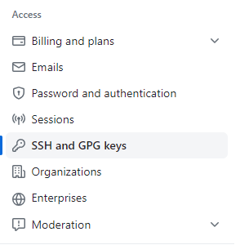
Add the public key to GitHub
Check for existing OpenSSH key pairs:
ls ~/.ssh
Generate OpenSSH keys if no key pairs exist:
ssh-keygen -t rsa -b 4096 -C email@example.com
private key: id_rsa
public key: id_rsa.pub
Add the Public Key to GitHub:

Slide 27
Secure Copy Protocol
SCP uses SSH as its transport, so everything is automatically encrypted. It works like the cp command, but source or destination can be user@host:path.
Three patterns:
Upload: scp <local-file> user@<server>:<remote-path>
Download: scp user@<server>:<remote-file> <local-path>
Directory: scp -r <local-dir> user@<server>:<path>

Slide 28
Demo 4
ssh & scp
Log in to a remote machine securely
Transfer files over an encrypted connection

